Slide 1
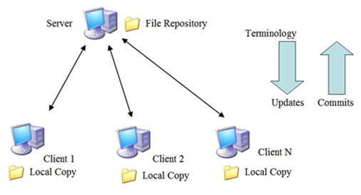
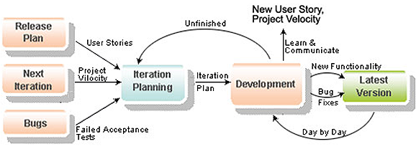
Testing
Controlling and Monitoring
Source code
Code repository
Subversion
Team member
Meeting
Assign task
Tracking task
Issue resolve
Review task
Report

Slide 2

Communication control
Online activity
Email
Google group
Chat
Phone
Offline activity
Kick-Off project
Daily and weekly meeting
Working together from Mon to Sat
Team building

Slide 3
Test plan
Test Stage
Type of Test | Stage of Test
 | Unit | Intergration | System
Functional Test | X | X | X
User Inteface Test
Data Volume Test
Test Schedule
Test Schedule | Start Date | Finish Date
Unit/Function Testing
User Interface Testing
User Acceptance Testing

